Slide 1
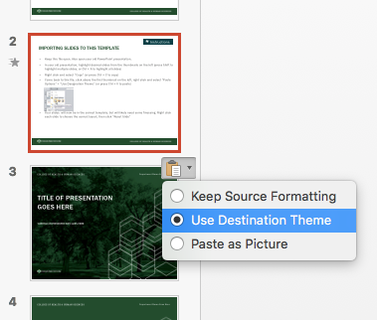
IMPORTING SLIDES TO THIS WIDESCREEN (16:9) TEMPLATE
Instructions
Keep this file open. Also open your old PowerPoint presentation.
In your old presentation, highlight desired slides from the thumbnails on the left
(press Shift to highlight multiple slides, or Ctrl or Cmd + A to highlight all slides)
Right click and select “Copy” (or press Ctrl or Cmd + C to copy)
Come back to this file, click above the first thumbnail on the left, right click and select
“Paste Options” > “Use Destination Theme” (or press Ctrl or Cmd + V to paste)
Your slides will now be in the correct template, but will likely need some finessing.
Right click each slide to choose the correct layout, then click “Reset Slide”
Note: This template’s slide size is Widescreen (16:9).

Slide 2
COLOR PALETTE + FONTS
Accessibility Color Contrast
The following colors have enough contrast when used with white (i.e., white text on color background or color text on white background):
PMS 357 PMS 316 black
The following color can also be paired with white, but ONLY when using larger type (18 pt. bold or larger):
PMS 7559
--------------------------------
The following colors have enough contrast when used with black:
PMS 617 PMS 584 PMS 570
PMS 138 white
The following color can also be paired with black, but ONLY when using larger type (18 pt. bold or larger):
PMS 7559
--------------------------------
All other colors can be used for visual accents, but not text.
Colorado State University Palette
College of Health and Human Sciences Palette
R
G
B
30
77
43
PMS 357
1E4D2B
200
195
114
PMS 617
C8C372
255
255
255
White
FFFFFF
64
65
64
Black
000000
R
G
B
208
219
66
PMS 584
D5DE53
170
72
46
PMS 7599
AB4224
133
186
175
PMS 570
8AC4B3
0
62
70
PMS 316
003D46
225
150
62
PMS 138
DF8E2E
Check color contrast with the WebAIM Contrast Checker using the six-letter/number hexadecimal code below each PMS color name.
Presentation font is Franklin Gothic Medium for Headings
Presentation font is Franklin Gothic Book for Body

Slide 3
TITLE OF PRESENTATION
GOES HERE
SUBTITLE OR PRESENTER INFO GOES HERE

Slide 4
TITLE OF PRESENTATION
GOES HERE
SUBTITLE OR PRESENTER INFO GOES HERE

Slide 5
HEADER + CONTENT SLIDE
Slide content goes here
Slide content goes here
Slide content goes here

Slide 6
HEADER + CHART SLIDE

Slide 7
HEADER ONLY SLIDE

Slide 8
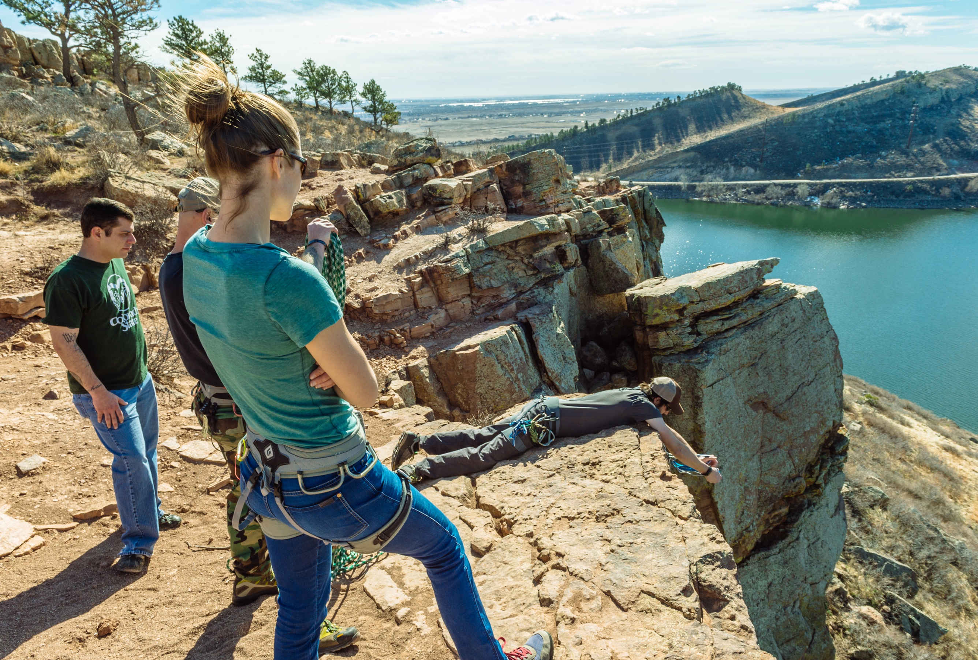
HEADER + CONTENT AND PICTURE SLIDE
Slide content goes here
Slide content goes here
Slide content goes here

Slide 9
SECTION TITLE
GOES HERE

Slide 10
SECTION TITLE
GOES HERE

